Slide 1
Artificial Intelligence
Intelligent Automation….
Powered by machines… and a tad bit of human intellect
De-mystifying AI

Slide 2
Agenda for the next hour together!
1 – What is AI and where are we really…..
2 – Mindset shift
3 – Impact on People
Discussion Topics - Working session!:
  How do we enable this mindset shift?
  How do we ready people for this shift?
Call to Action: Don’t wait for it to be figured out as it is not your typical mass markets product it is how you use it to solve your business opportunities and how you transform you organization to make it work

Slide 3
No artificial here….
Terry Pirovolakis | Lead Contact Centre Strategist, CIBC
Flavio Pereira, CEO Nuveo.ai
Nygel Weishar | Director – Non Voice Media Strategy | CIBC
Yury Pyatetskiy , Sr. Manager - AI incubation, RBC

Slide 4
Artificial Intelligence (AI): …computer systems able to perform tasks that normally require human intelligence, such as visual perception, speech recognition, decision-making, and translation between languages ….Wikipedia
something if done by Humans would be considered Intelligent

Slide 5
Intelligent Automation(IA): “the combination of artificial intelligence and automation“ ….Deloitte. insights
Intelligent automation systems sense and synthesize vast amounts of information and can automate entire processes or workflows, learning and adapting as they go.

Slide 6









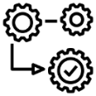
Artificial Intelligence is not a “thing”
  A collection of components all working in unison
  Not new technology
  The Art of putting together
NLP
Biometrics
Comp Vision
Machine Learning
Cognitive
Neural net
Deep Learning
Block Chain
Understand the “WHAT”
Decide on the “HOW”
DO IT!
IOT
Augmented
Reality
ABILITY TO SENSE
SHARP TO THINK
QUICK TO ACT
Notes:
Not a Thing – like a CRM / ERP / Work Flow systems
Collection of things

Slide 7
Intelligent Automation
Artificial Intelligence
Robotic Process
Automation (RPA)
Machine Learning
Deep Learning
NLP
iOCR
OCR
Biometrics
Computer Vision
Desktop Automation
Intent Engines
Neural Nets
Script Automation
Run Book automation
Virtual Agents
Deep Data analytics
Chat Bots
Intelligent Search
Fractal Sciences
Rules Based
Requires structured data
Judgment Based
Unstructured Data

Slide 8
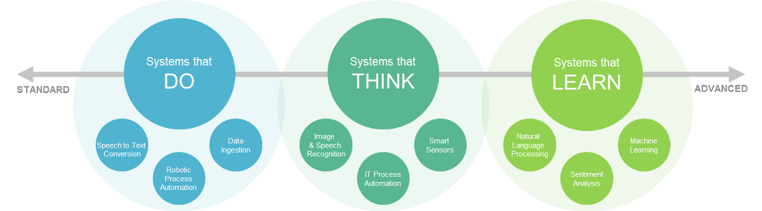
Organizing AI and IA components
speech to text, robotics, data ingestion - DO
  AI utilities drive the THINK and LEARN
    Data readiness will determine success

Slide 9
Organization have many pockets of AI organized on outcomes
Client experience
Predicting
Process Improvement

Slide 10



Chat Bot / Virtual assistant unpacked
User
Interface
Intelligence Search
2
Direct Machine Text
3
1
Fulfillment
Intent Engine
Lots of Hype
Lots of Tools
Complicated to put together
Voice / Face to face

Slide 11
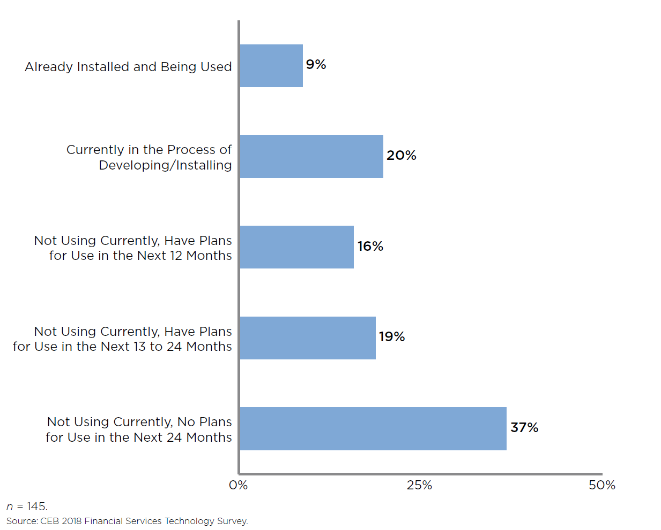
Lots of experimentation and learning
Insert info from
Most of the industry is learning and piloting…… which speaks to the mindset shift and readiness effort

Slide 12
Generational opportunity
AI not a thing – how things fit together
Sense, Learn, Do
AI is in early stages

Slide 13
THE Mindset shift:
Build new Integration - How things fit together
Ownership Enablement – How do I enable…….
Silo‘d accountability Hybrid Teams – Work as one team….
Linear process Event driven process
FROM:
TO:
How we work, How we business Case, New Concepts

Slide 14
How we Work Shift
Operating model
  Business and Tech teams operating as one team
  Experience / culture first
  Day 2 or BAU of the future
How we work
  Agile, Waterfall, Iterative Waterfall
  Implications of all existing
Prioritization metrics = Speed and agility
Business
Technology
Trust takes on a new meaning

Slide 15

How we Business Case
Outcome based Business Casing and a Leap of faith
Don’t know:
what the solution is,
who I need allocated,
if I will build vs buy capability
how long it will take
Insulate our teams from tradition business case reporting……
Stakeholder engagement more important….
Metrics more important than ever

Slide 16
New Concepts….
Challenge Organizational Culture……
Human in the Loop
Confidence ratings
Prediction accuracy
Data Readiness
…….. Expect 80% to start
…….. Not one size fits all processes
…….. Accuracy in wrong predictions are more valuable
Data is never ready.... To the level you need…..

Slide 17
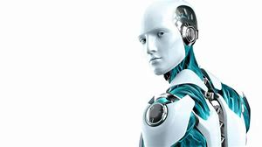
Value in starting with the RPA quadrant first
1 – RPA hype is real – drives benefits to enable Mindset shift
2 – Operating Model
3 – Data readiness enablement
4 – Human to Bot interaction
Business
Technology

Slide 18
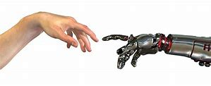
Impact on People and Engagement
This topic feels different than that of the past!
Advice will be richer experience and less idle
or low value capacity
What people do will be different – workforce largely the same
Creativity new hot skill and many new roles emerging…….
In the future the total workforce will likely be unchanged but what we do, how we work will be very different.

Slide 19
The Impact of the AI mindset shift on how we lead and build our organizational culture.
As you are seeing this shift happen what is the biggest learning / observation to share?
What are the top three challenge you see as a leader in supporting this mindset shift?
How can we as leaders enable this?
What implications does / could this have on the overall customer experience?

Slide 20
The impact of AI on the employee and employee engagement?
As an industry, what do we need to focus on to enable our employees through this journey?
What tactics are you taking or seeing in the industry that will help to enable our employees?
What are you worried about as it relates to employee engagement?

Slide 21

It was the bots fault!
Machines to what they are told and to it consistently….

